Slide 1
Mini Project Presentation E-Commerce Website
Presented By:
Avyakt Pratap Singh (171500069)
Krishna Kant Singh (171500164)
Abhishek kumar (171500010)

Slide 2
Overview
Introduction
Definition
Future Scope
Feasibility
Technology used
Design
Project Module
Screenshot’s

Slide 3
INTRODUCTION
Online Shopping is a form of electronic commerce whereby consumers directly buy goods and services from a seller over internet without an intermediary service.
This project reduces a lot of work load for customer as well as owner.
Online shopping site helps to choose products faster and easier at one place

Slide 4
DEFINITION
Online Shopping is the process whereby Consumers directly buy goods or services from a seller in real-time , without an intermediary services , over the internet.

Slide 5
FUTURE SCOPE:
The project made here is just to ensure that this product could be valid in today real challenging world. Here all the facilities are made and tested.
Currently it is not visible on virtual world (Internet) because of some limitations of project. In future it may be there.

Slide 6
FEASIBILITY:
Technical Feasible:-
Technically, this project is very feasible because of use of current and latest techniques.
Financial Feasible:-
Financially, It is also very feasible it made up in very low cost and will be free for all.
Operational Feasible:-
Very easy to use.

Slide 7
Technology Used
Frontend
1. HTML And CSS
2. Bootstrap
3. Java Script
Backend
1. PHP
2. My SQL

Slide 8
HTML
HTML is the standard markup language for documents designed to be displayed in a web browser
With HTML constructs, images and other objects such as interactive forms may be embedded into the rendered page

Slide 9
CSS
It is used for styling of pages written in HTML
CSS is designed to enable the separation of content including
Fonts and layouts

Slide 10
PHP
PHP: Hypertext Preprocessor (or simply PHP) is a general-purpose programming language originally designed for web development.
It is basically Server side scripting language
Code written in PHP are executed on server side

Slide 11
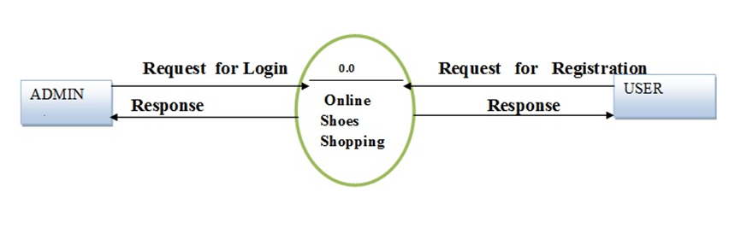
DESIGN

Slide 12
Project Module
Signup Module
Login Module
Cart Module
Homepage Module
Database Module
Image upload

Slide 13
LOGIN MODULE
Login Module led the user to login to his account by his unique username and password
User can also logout his account after doing his task.

Slide 14
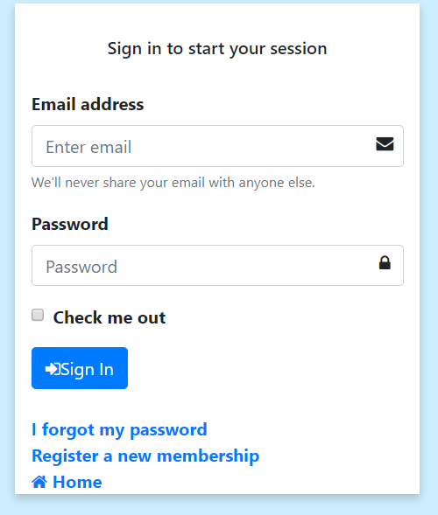
Login Module/Screenshot

Slide 15
SIGNUP MODULE
Signup Module led the user to create his account on the website.
For signup you must have a username(first , last name) ,email and a password.

Slide 16
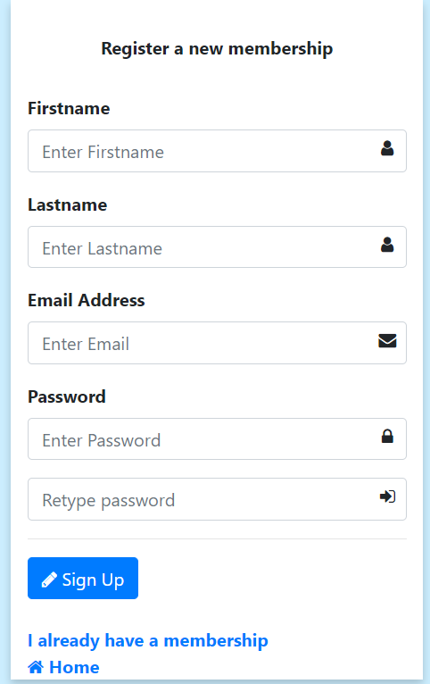
Signup Module/Screenshot

Slide 17
CART MODULE
It is an important module of the project as it help to order the product bought.
The user can select the product of there choice and add to the cart for the further processing.
The cart has a feature to increase the quantity of each product.

Slide 18
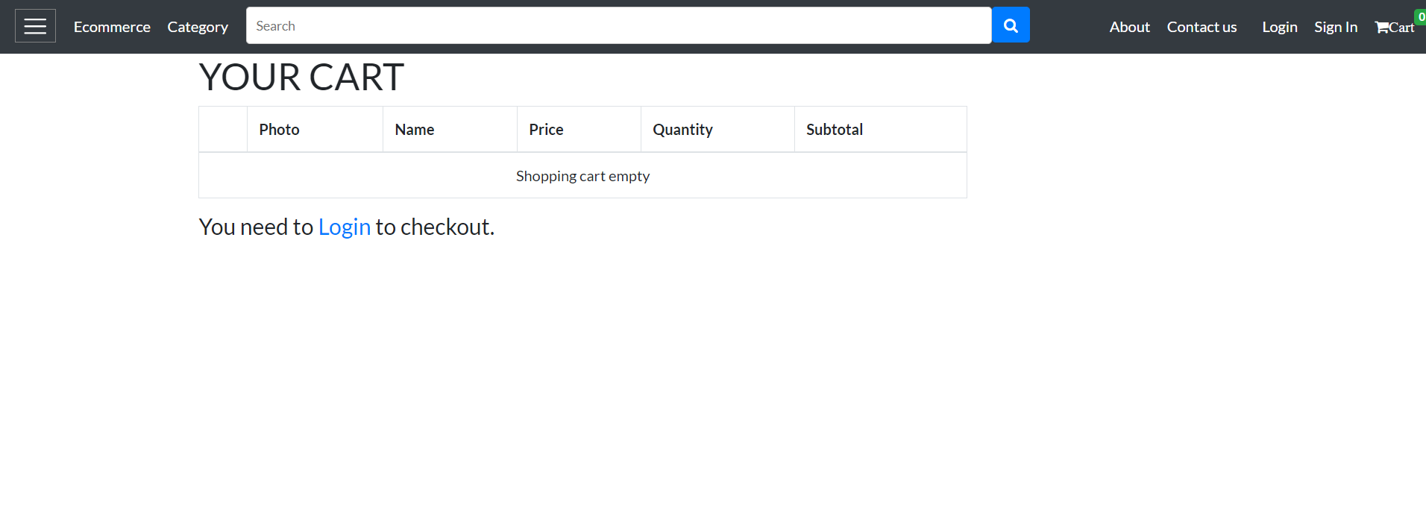
Cart Module/Screenshot

Slide 19
HOMEPAGE MODULE
In this Module all the product list is given.
This is the page which opens on opening the website.
This is the page from where all the links to different page is
given .

Slide 20
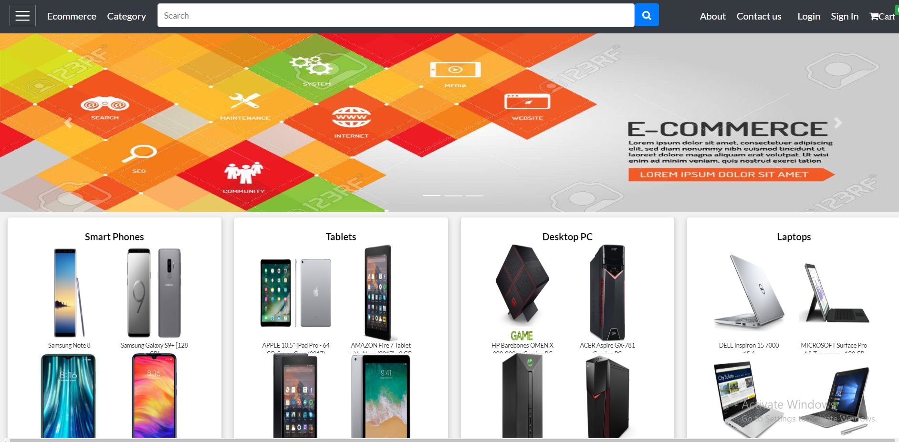
Homepage Module/Screenshot

Slide 21
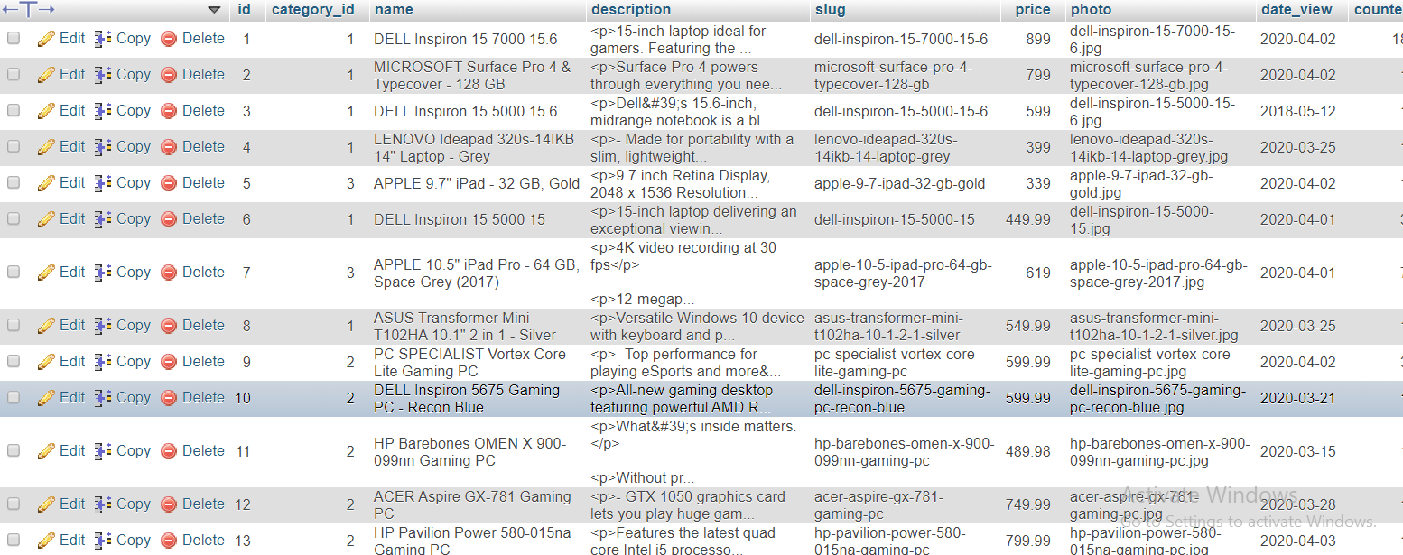
DATABASE
Image data :

Slide 22
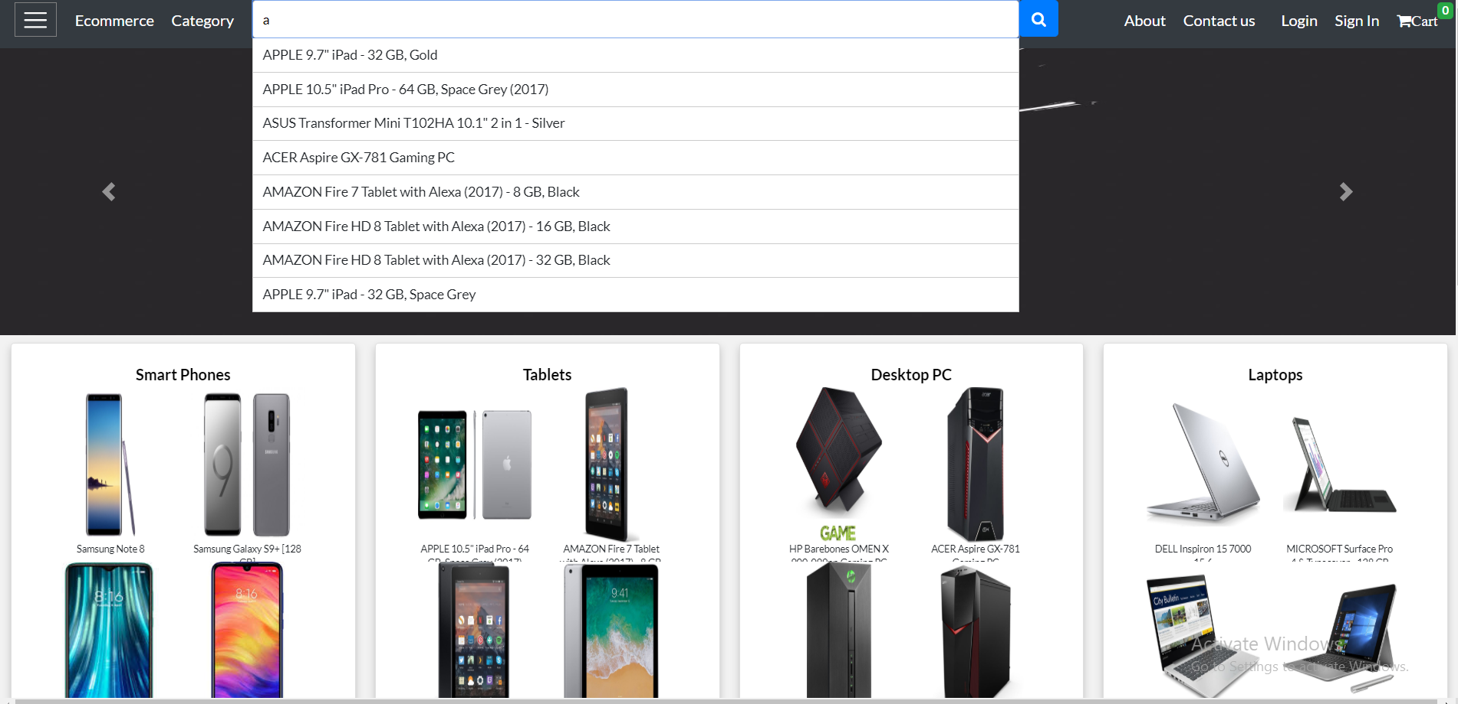
Live Search/Screenshot

Slide 23
CONCLUSION
Online shopping is the best way to purchase any item but he careful because there may be some fake products on different sites.
Only purchase those item which can be recognised easily that item is fake or not or choose according rating of buyers.
with new technology comes better way of doing things.

Slide 24
REFERENCES
https://www.geeksforgeeks.org/
https://www.w3schools.com/
https://stackoverflow.com/
https://www.php.net/

Slide 25
THANK YOU : )

